Slide 1
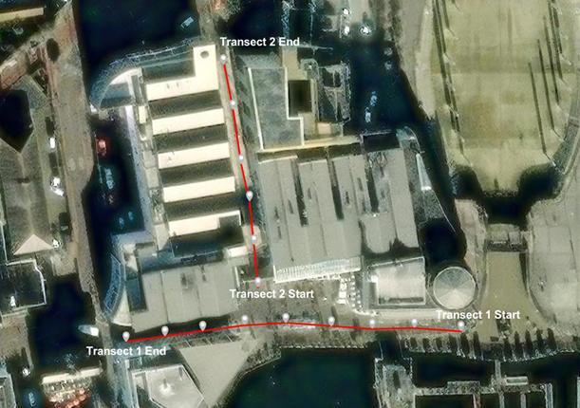
- CCTV
A - Alarm
- Anti-Homeless Architecture

